Slide 1
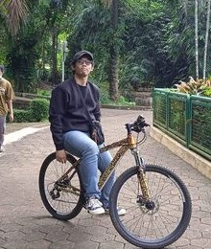
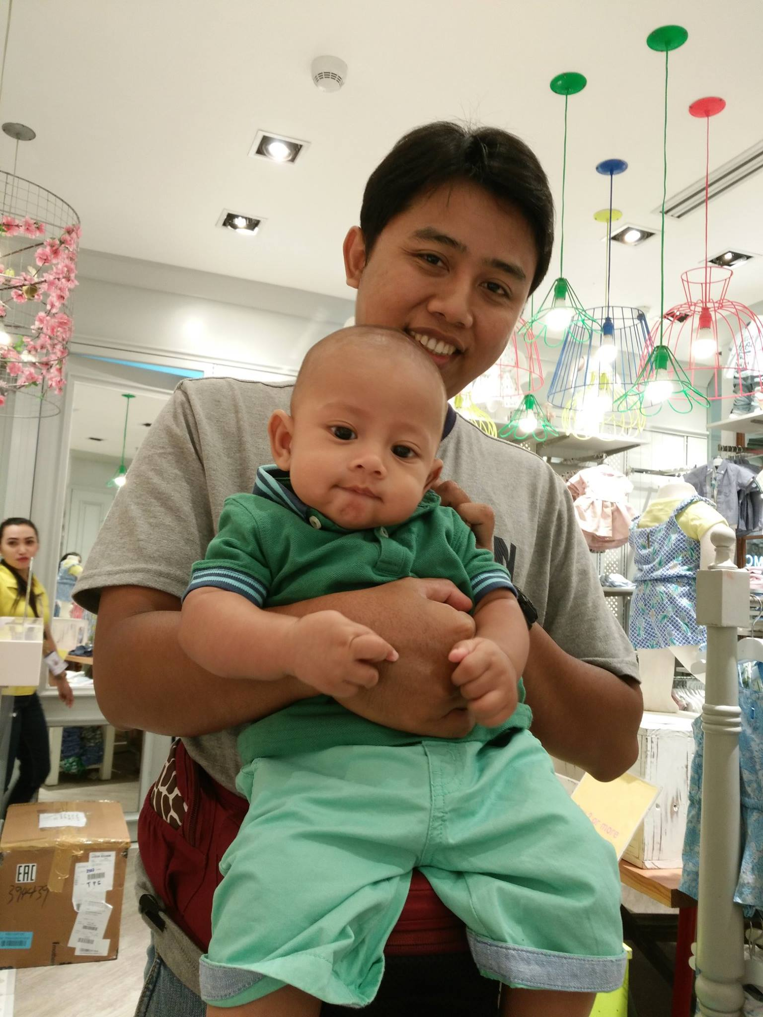
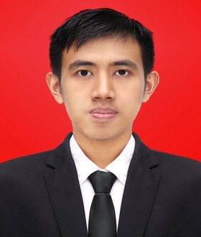
Kelompok Grup A
Ahmad Irfaan Hibatullah Anggoro Budiono Muhamad Habib

Slide 2
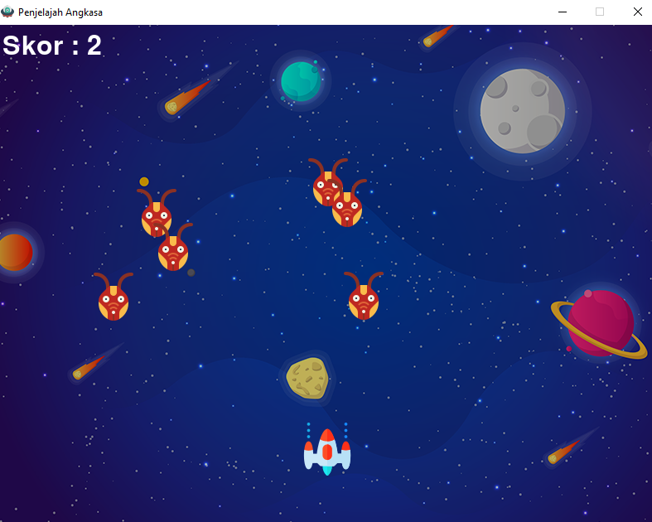
Penjelajah Angkasa

Slide 3
Kode program
import math
import random
import pygame
from pygame import mixer
pygame.init()
layar = pygame.display.set_mode((800, 600))
latar_belakang = pygame.image.load('latar_belakang.png')
mixer.music.load("suara_latar_belakang.wav")
mixer.music.play(-1)
pygame.display.set_caption("Penjelajah Angkasa")
ikon = pygame.image.load('ikon_game.png')
pygame.display.set_icon(ikon)
gambar_pemain = pygame.image.load('pemain.png')
pemain_x = 370
pemain_y = 480
pemain_x_berganti = 0

Slide 4
Kode program
gambar_musuh = []
musuh_sumbu_x = []
musuh_sumbu_y = []
musuh_sumbu_x_berganti = []
musuh_sumbu_y_berganti = []
jumlah_musuh = 6
for i in range(jumlah_musuh):
gambar_musuh.append(pygame.image.load('musuh.png'))
musuh_sumbu_x.append(random.randint(0, 736))
musuh_sumbu_y.append(random.randint(50, 150))
musuh_sumbu_x_berganti.append(4)
musuh_sumbu_y_berganti.append(40)
gambar_peluru = pygame.image.load('peluru.png')
peluru_x = 0
peluru_y = 480
peluru_x_berganti= 0
peluru_y_berganti= 10
keadaaan_peluru = "siap"

Slide 5
Kode program
skor = 0
jenishuruf = pygame.font.Font('freesansbold.ttf', 32)
text_x = 10
text_y = 10
akhir_jenishuruf = pygame.font.Font('freesansbold.ttf', 64)
def tampil_nilai(x, y):
skor1 = jenishuruf.render("Skor : " + str(skor), True, (255, 255, 255))
layar.blit(skor1, (x, y))
def text_game_akhir():
text_akhir = akhir_jenishuruf.render("GAME OVER", True, (255, 255, 255))
layar.blit(text_akhir, (200, 250))
def pemain(x, y):
layar.blit(gambar_pemain, (x, y))
def musuh(x, y, i):
layar.blit(gambar_musuh[i], (x, y))

Slide 6
Kode program
def tembak_peluru(x, y):
global keadaaan_peluru
keadaaan_peluru = "tembak"
layar.blit(gambar_peluru, (x + 16, y + 10))
def ada_tambrakan(musuh_sumbu_x, musuh_sumbu_y, peluru_x, peluru_y):
jarak = math.sqrt(math.pow(musuh_sumbu_x - peluru_x, 2) + (math.pow(musuh_sumbu_y - peluru_y, 2)))
if jarak < 27:
return True
else:
return False

Slide 7
Kode program
game_berjalan = True
while game_berjalan:
layar.fill((0, 0, 0))
layar.blit(latar_belakang, (0, 0))
for event in pygame.event.get():
if event.type == pygame.QUIT:
game_berjalan = False
if event.type == pygame.KEYDOWN:
if event.key == pygame.K_LEFT:
pemain_x_berganti = -5
if event.key == pygame.K_RIGHT:
pemain_x_berganti = 5
if event.key == pygame.K_SPACE:
if keadaaan_peluru is "siap":
suara_peluru = mixer.Sound("suara_peluru.wav")
suara_peluru.play()
peluru_x = pemain_x
tembak_peluru(peluru_x, peluru_y)
if event.type == pygame.KEYUP:
if event.key == pygame.K_LEFT or event.key == pygame.K_RIGHT:
pemain_x_berganti = 0

Slide 8
Kode program
pemain_x += pemain_x_berganti
if pemain_x <= 0:
pemain_x = 0
elif pemain_x >= 736:
pemain_x = 736
for i in range(jumlah_musuh):
if musuh_sumbu_y[i] > 440:
for j in range(jumlah_musuh):
musuh_sumbu_y[j] = 2000
text_game_akhir()
break
musuh_sumbu_x[i] += musuh_sumbu_x_berganti[i]
if musuh_sumbu_x[i] <= 0:
musuh_sumbu_x_berganti[i] = 4
musuh_sumbu_y[i] += musuh_sumbu_y_berganti[i]
elif musuh_sumbu_x[i] >= 736:
musuh_sumbu_x_berganti[i] = -4
musuh_sumbu_y[i] += musuh_sumbu_y_berganti[i]

Slide 9
Kode program
# Tabrakan
tabrakan = ada_tambrakan(musuh_sumbu_x[i], musuh_sumbu_y[i], peluru_x, peluru_y)
if tabrakan:
suara_tembakan = mixer.Sound("ledakan.wav")
suara_tembakan.play()
peluru_y = 480
keadaaan_peluru = "siap"
skor += 1
musuh_sumbu_x[i] = random.randint(0, 736)
musuh_sumbu_y[i] = random.randint(50, 150)
musuh(musuh_sumbu_x[i], musuh_sumbu_y[i], i)

Slide 10
Kode program
if peluru_y <= 0:
peluru_y = 480
keadaaan_peluru = "siap"
if keadaaan_peluru is "tembak":
tembak_peluru(peluru_x, peluru_y)
peluru_y -= peluru_y_change
pemain(pemain_x, pemain_y)
tampil_nilai(text_x, text_y)
pygame.display.update()

Slide 11
Demo

Slide 12
TERIMA KASIH
pERHATIANNYA

